Slide 1
Recent results and plans of the NA64 experiment
Mikhail Kirsanov
JINR
Physics of Particles at Medium and High Energies
Protvino, 2026

Slide 2
Outline
Motivation
The NA64 experiment (initial motivation, development)
Simulation of the Dark Matter production: DMG4 package
Method, its development, Thermal DM
Plans for the invisible mode
Other types of DM, B-L model
ALP search in invisible mode configuration
Visible mode: X-boson, results, new project, new ideas
(g-2)_{μ} and NA64μ results and plans
NA64h: searches in hadron beams

Slide 3

Vector portal to Dark Sector (initial motivation)
α_{D}=e_{D}²/4π
Okun, Holdom’86 ..
´
e⁺
χ
e
e_{D}
e⁻
new massive boson A´(dark photon) which has kinetic mixing with ordinary photon: ΔL = ε/2 F ^{μν}A´_{μν}
Production: A´- bremsstrahlung e⁻ Z→ e⁻ Z A´, σ∼Z²ε²/m_{A´}²
Decays:
- Visible: A´→ e⁺e⁻, μ⁺μ⁻, hadrons,..
- Invisible: A´→ χχ if m_{A´} > 2mχ assuming α_{DM} ~ α >> ε.
Can explain (g-2)_{μ}, astrophys. observations
Cross section for χ−DM annihilation: σν ∼ [α_{DM} ε²(m_{χ}/m_{A´})⁴] α/m_{χ}²
χ
_
y

Slide 4
Thermal dark matter
Assume that in the early Universe dark matter is in equilibrium with the SM matter. At some temperature the dark matter decouples
DM density today tells us about the annihilation cross-section. Correct DM density corresponds to <σ_{an}v> ∼ O(1) pbn
Most popular models of light (sub-GeV) dark matter χ:
Scalar dark matter
Majorana dark matter
Pseudo Dirac dark matter

Slide 5
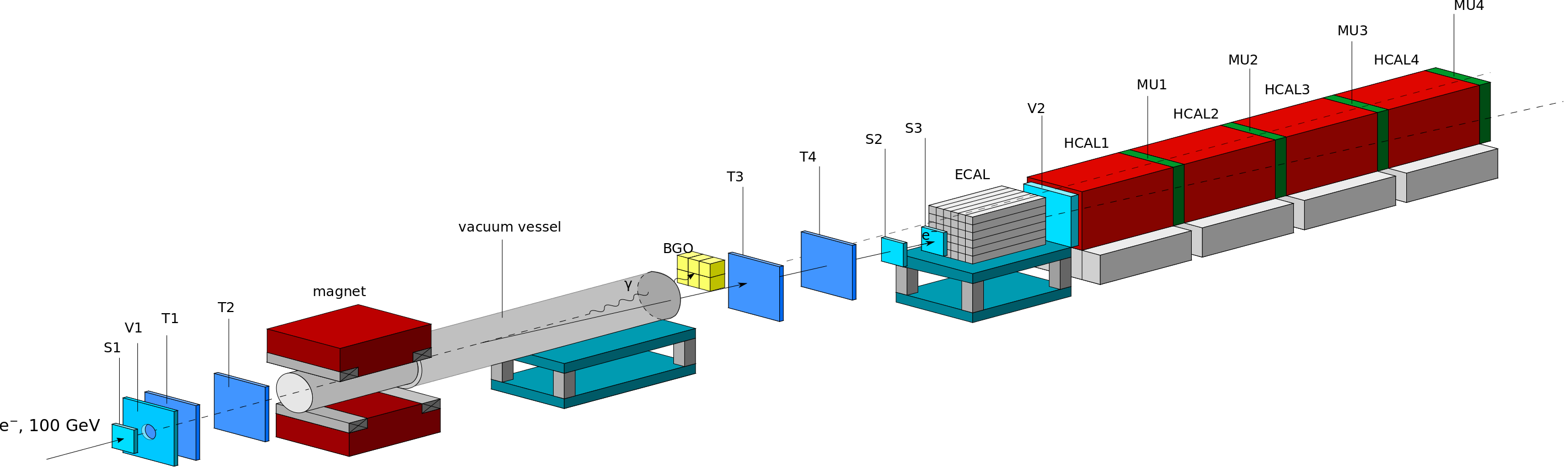
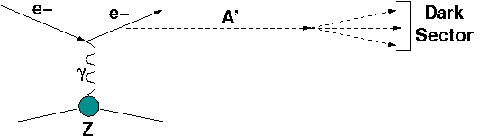
Search for A´->invisible decays at CERN SPS
SES < 10⁻¹¹/EOT
Signature:
in: 100 GeV e- track
out: E_{ECAL}< E₀ shower in ECAL
no energy in Veto and HCAL
S.Andreas et al., arXiv: 1312.3309
S.G., PRD(2014)
Main components :
clean 100 GeV e- beam
e- tagging system: MS+SRD
hermetic ECAL+HCAL
Background:
μ, π, K decays in flight
upstream interactions
Tail < 50 GeV in the e- beam
Energy leak from ECAL+HCAL

Slide 6
NA64 collaboration
More than 53 physicists from 15 institutes
> 50% from RF (initially) + JINR
Contributions:
ETH: Micromegas track detectors
JINR: Straw tubes
Chile: Movable table for HCAL, LYSO SRD
INFN: New electronics, POKER EM calorimeter, MINIPOKER
Notes:
-PF muon ID uses information from additional sub-detectors
to suppress further background.
-Isolated Muons are required to pass Loose selection
-Muons inside jets need higher identification criteria
to reject punch through and fakes so they are subject to
tighter selection
-Some muons that fail the tight selection can be later
recovered during the track-calorimeter cluster linking

Slide 7
IHEP Protvino contribution
ECAL: Shashlyk EM calorimeter: active target
HCAL (4 modules)
VETO counter
WCAL compact calorimeter
SRD: Synchrotron Radiation detector, fine-grained sandwich calorimeter
VHCAL (2 modules) – Veto calorimeter with a hole (kind of guard system)
ECAL to substitute the old one
ZDCAL – Zero degree calorimeter (part of guard system)
Wide HCAL (2 modules) – for NA64mu
Expertise
Пользуясь случаем я хотел бы от лица коллаборации NA64
поблагодарить - НИЦ КИ ИФВЭ за помощь
и участие в предложении, подготовке и проведении
эксперимента NA64 начиная с первых его шагов в 2014 г.
И также мы хотели бы выразить нашу особую искреннюю
благодарность Н.Е. Тюрину, а также В.А. Качанову
за всестороннюю поддержку и помощь в осуществлении
этого проекта на всех его этапах
без которых этот эксперимент просто бы не состоялся.
Notes:
-PF muon ID uses information from additional sub-detectors
to suppress further background.
-Isolated Muons are required to pass Loose selection
-Muons inside jets need higher identification criteria
to reject punch through and fakes so they are subject to
tighter selection
-Some muons that fail the tight selection can be later
recovered during the track-calorimeter cluster linking

Slide 8
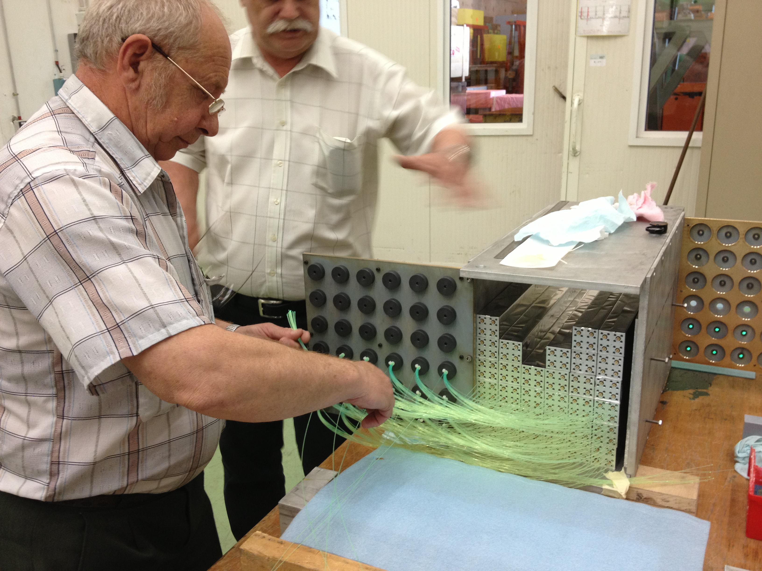
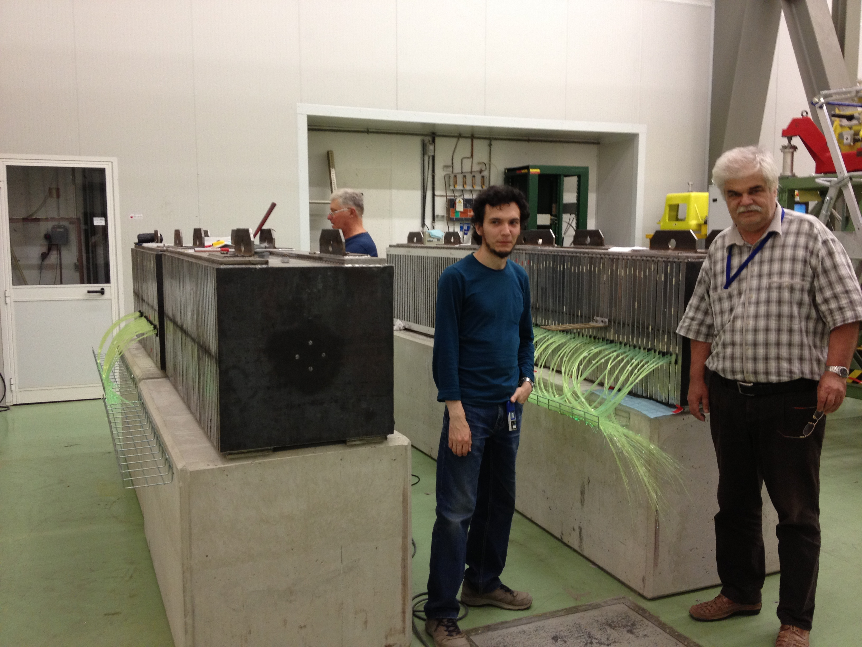
Assembling NA64 subdetectors (2015)
Notes:
-PF muon ID uses information from additional sub-detectors
to suppress further background.
-Isolated Muons are required to pass Loose selection
-Muons inside jets need higher identification criteria
to reject punch through and fakes so they are subject to
tighter selection
-Some muons that fail the tight selection can be later
recovered during the track-calorimeter cluster linking

Slide 9

NA64 development in 10 years
2016 – 2018 – Approved by CERN as NA64 (was P348), initial runs
2021 – Permanent place in NA
2021, 2022 – new ECAL 5x6 (same design)
2022 – More compact geometry, new low material budget MM
2022 – Start to upgrade electronics
2022 - Added end spectrometer to study dimuons and possibly new physics
2024 – Add VHCAL0
2025 – Add VHCAL1
2025 – Use new more sensitive SRD, LYSO crystals from Chile, important for low energy positron runs
2025 – Use PKRCAL from INFN Genova group (PWO crystal better segmented target – calorimeter, 9x9 segmentation) in positron runs
2025 – New 3 times faster waveboard is used for PMT based detectors
2021 --> SW: Work on the DMG4 package for the simulation of DM events, development, improvements, testing
2025 --> SW: Waveform reconstruction using fits, potentially better energy resolution in conditions of high pile-up
Notes:
-PF muon ID uses information from additional sub-detectors
to suppress further background.
-Isolated Muons are required to pass Loose selection
-Muons inside jets need higher identification criteria
to reject punch through and fakes so they are subject to
tighter selection
-Some muons that fail the tight selection can be later
recovered during the track-calorimeter cluster linking

Slide 10
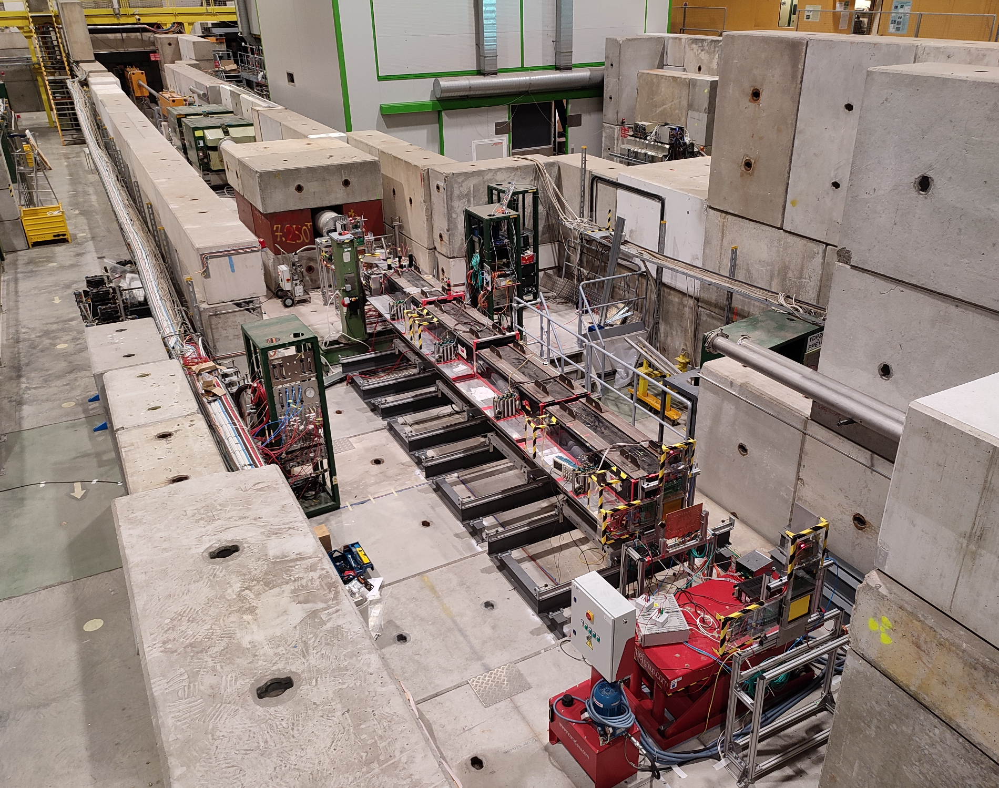
NA64 in 2021-2022, permanent place at H4 prepared by the CERN Beam Division
Notes:
-PF muon ID uses information from additional sub-detectors
to suppress further background.
-Isolated Muons are required to pass Loose selection
-Muons inside jets need higher identification criteria
to reject punch through and fakes so they are subject to
tighter selection
-Some muons that fail the tight selection can be later
recovered during the track-calorimeter cluster linking

Slide 11
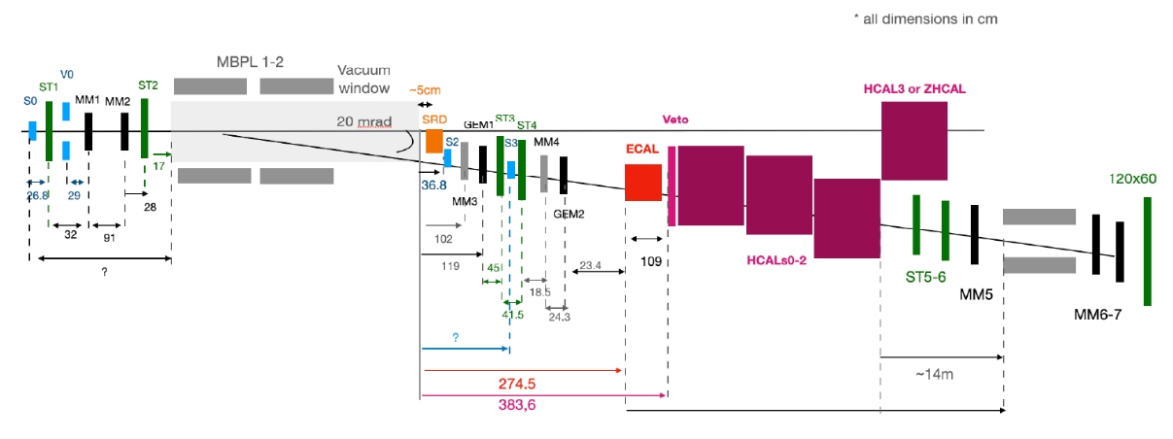
NA64 in 2022
Notes:
-PF muon ID uses information from additional sub-detectors
to suppress further background.
-Isolated Muons are required to pass Loose selection
-Muons inside jets need higher identification criteria
to reject punch through and fakes so they are subject to
tighter selection
-Some muons that fail the tight selection can be later
recovered during the track-calorimeter cluster linking

Slide 12
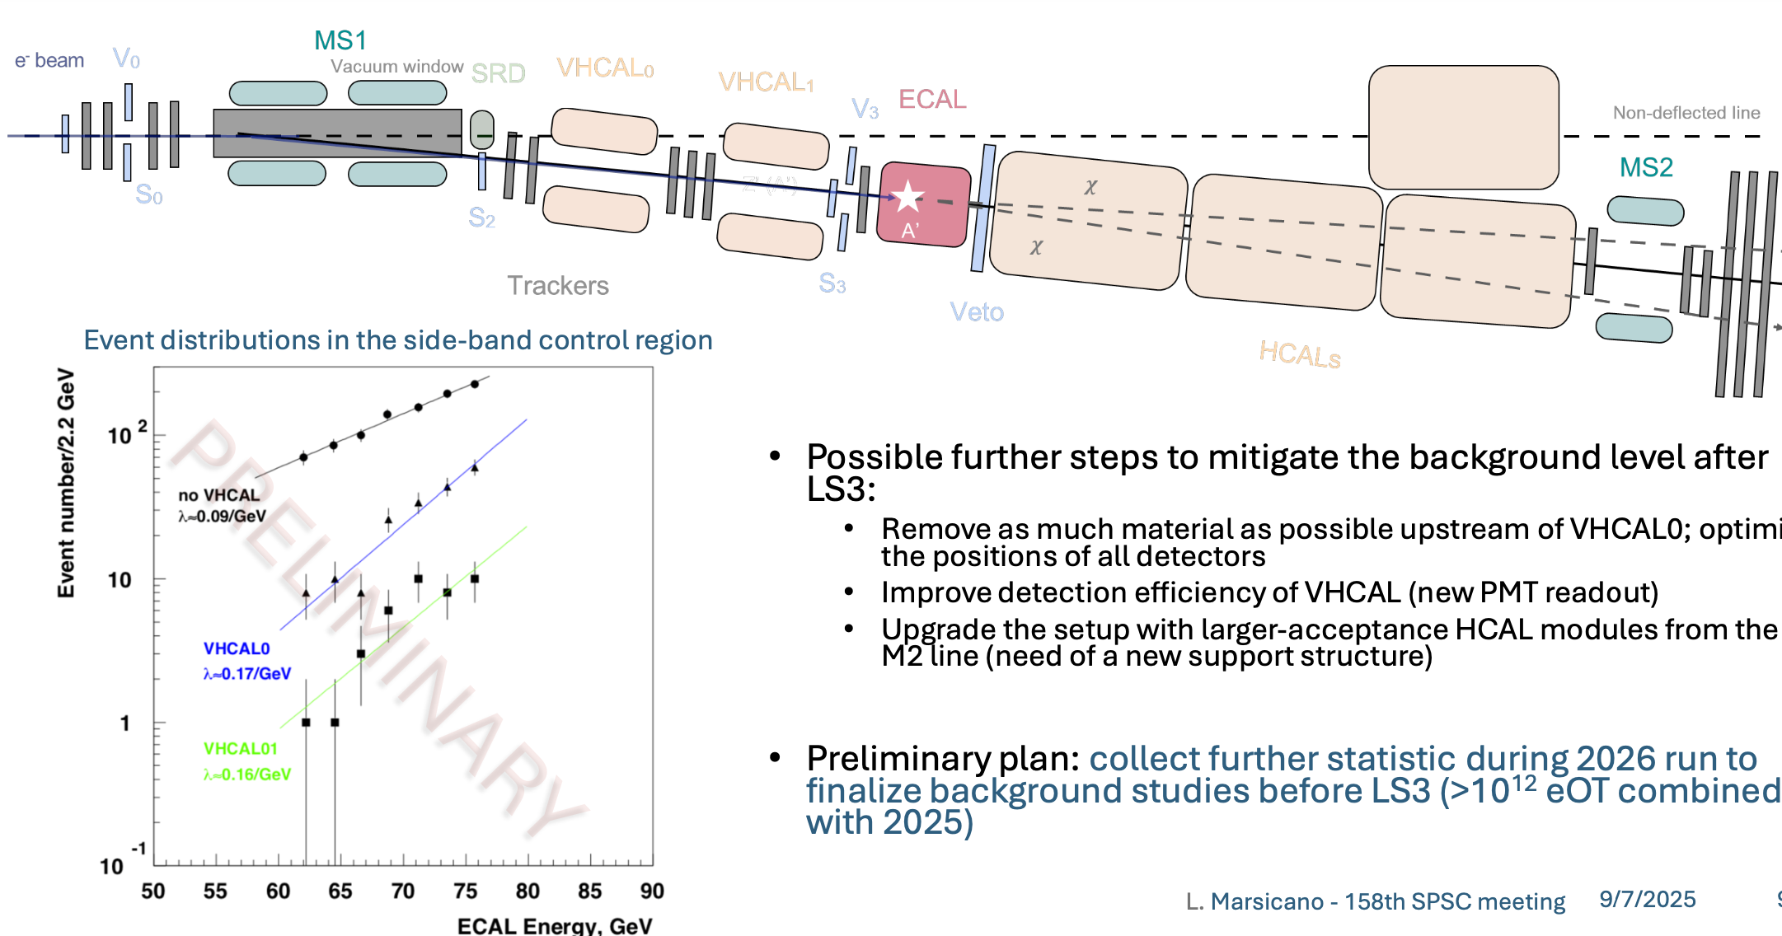
NA64 in 2025 - 2026
Notes:
-PF muon ID uses information from additional sub-detectors
to suppress further background.
-Isolated Muons are required to pass Loose selection
-Muons inside jets need higher identification criteria
to reject punch through and fakes so they are subject to
tighter selection
-Some muons that fail the tight selection can be later
recovered during the track-calorimeter cluster linking

Slide 13
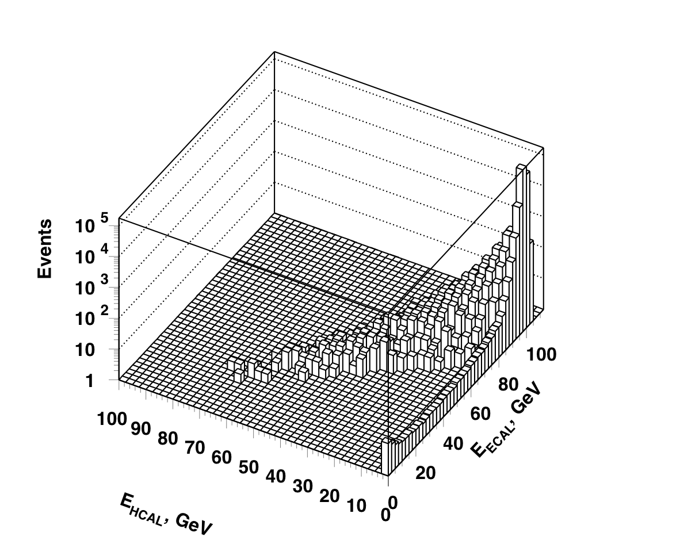
Simulation of eZ->eZA´; A´-> invisible @ BG
A´emission in the process of e-m shower development.
σ(e⁻Z->e⁻ZA´) (Bjorken et al. 2009)
SM events:
E_{ECAL}+E_{HCAL} ~ E₀
M_{A´}= 50 MeV
ε ≤10⁻¹
A´events:
E_{ECAL}<E₀; E_{HCAL}=0

Slide 14
DM processes simulation: DMG4
Fully Geant4 compatible package DMG4 is developed arXiv:2101.12192 [hep-ph]. Can be used in any full simulation program based on the Geant4 toolkit
Bremsstrahlung processes off electrons and muons (like eZ→eZA´), gamma conversion to ALP, annihilation processes (like e⁺e⁻→ A´→ χχ) can be simulated
DM messengers: vector (A´), axial vector, scalar, pseudoscalar, spin 2 (graviton), masses up to 3 GeV
Invisible and visible (to SM particles) decays
For the total cross section we use the full matrix element calculations (ETL) (arXiV:1712.05706 [hep-ph]) through the K-factors applied to the IWW cross sections. These K-factors can be as small as 1/15 for electrons at M_{A} ~ 1 GeV
A
Results
Future plans
Conclusion

Slide 15
DM processes simulation: DMG4(2)
Simplified IWW approximation in e⁻⁺ beams for differential cross sections (messenger masses > 1 MeV), sufficient accuracy. Messenger energy and angle are sampled
Tabulated e⁻⁺ beams differential cross section for masses < 1 MeV
Recently implemented WW approximation in muon beams Complicated analytical integration. Messenger energy and recoil muon angle are sampled by default (needed in analysis, see below)
WW formulas are now extended to scalar mediators
Recently implemented: spin 2 messengers
Recently implemented: semivisible decays of DM
Presented at ACAT-2021 and ACAT-2022
We continue to develop the package (convenience, new processes)
A
Results
Future plans
Conclusion

Slide 16
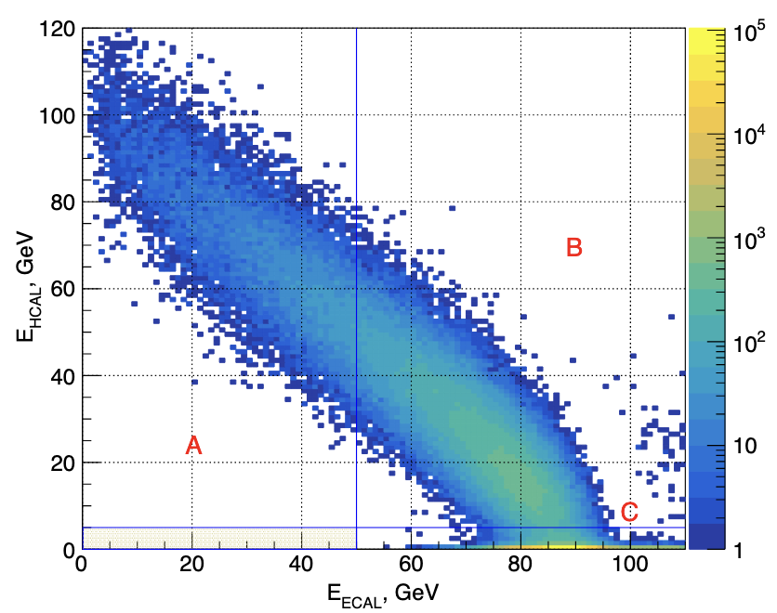
Analysis of data 2022
How is this shape formed?
Electron – nuclear and gamma – nuclear interactions
The main peak is cut off by trigger requirement E_{ECAL} < 85GeV
Notes:
-PF muon ID uses information from additional sub-detectors
to suppress further background.
-Isolated Muons are required to pass Loose selection
-Muons inside jets need higher identification criteria
to reject punch through and fakes so they are subject to
tighter selection
-Some muons that fail the tight selection can be later
recovered during the track-calorimeter cluster linking

Slide 17
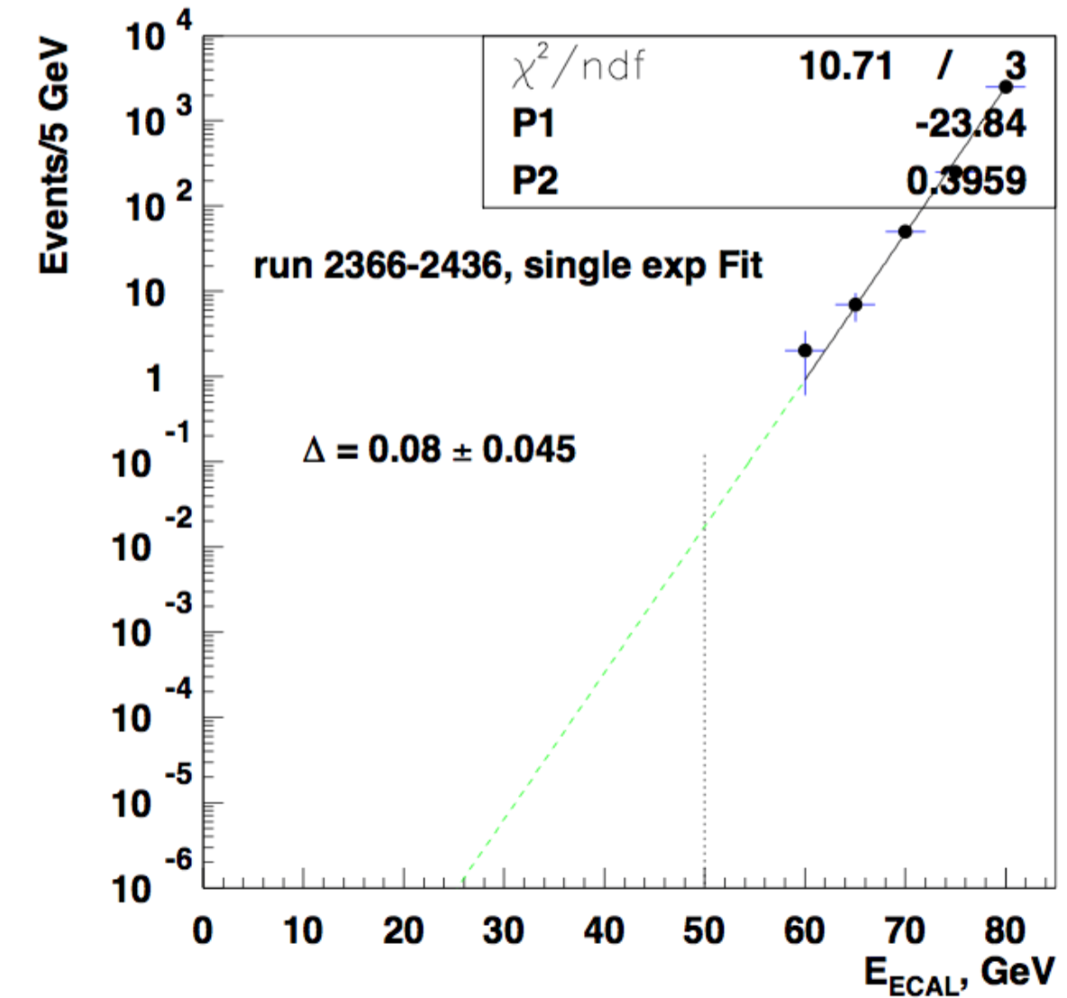
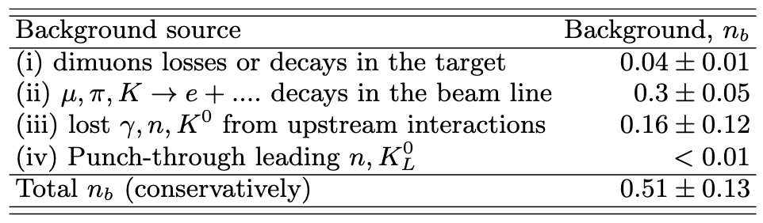
Background: example of extrapolation
Background sources runs 2021 - 2022
BG from the beam
elements (iii) is suppressed
by multiplicity cuts
in MM and Straw tubes
and by HCAL Topo cuts.
Estimated from extrapolation
Notes:
-PF muon ID uses information from additional sub-detectors
to suppress further background.
-Isolated Muons are required to pass Loose selection
-Muons inside jets need higher identification criteria
to reject punch through and fakes so they are subject to
tighter selection
-Some muons that fail the tight selection can be later
recovered during the track-calorimeter cluster linking

Slide 18
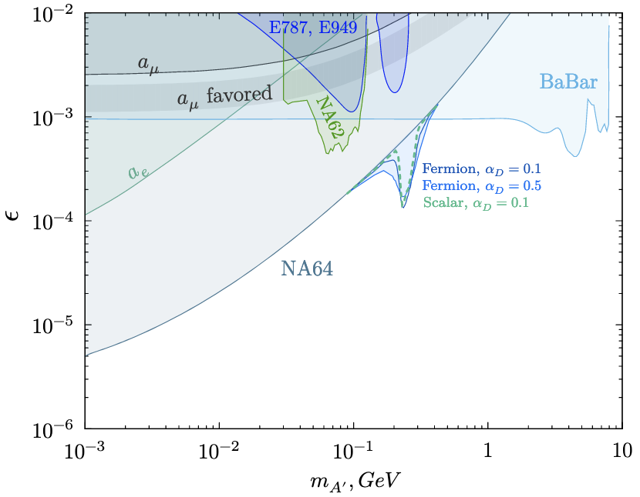
Results. Most recent on A’.
Phys. Rev. Lett. 131, 161801
(2023)
+ Resonant process:
shower positrons on
electrons of the target
e⁺e⁻→ A´→ χχ
First addition
to the analysis:
Phys. Rev. D 104, L091701
(2021)
Goal: add statistics
accumulated in 2023 – 2026
~2*10¹² EOT
(2023 is completed)
Notes:
-PF muon ID uses information from additional sub-detectors
to suppress further background.
-Isolated Muons are required to pass Loose selection
-Muons inside jets need higher identification criteria
to reject punch through and fakes so they are subject to
tighter selection
-Some muons that fail the tight selection can be later
recovered during the track-calorimeter cluster linking

Slide 19
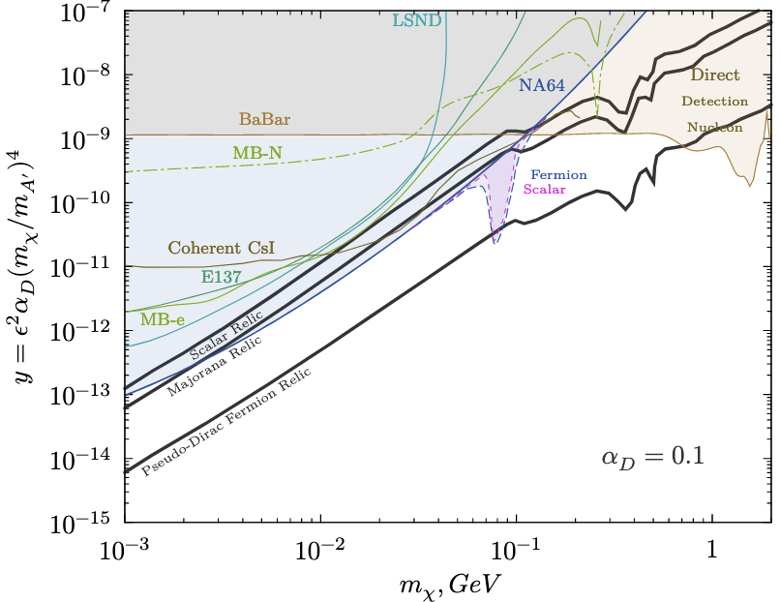
Limits in “cosmological” variables with 2022 data and sub-GeV Thermal Dark Matter models
α_{D} = 0.1, m_{A´} = 3m_{χ}
For α_{D} = 0.1 we cover
two models and
touch the third
Less strict limits for
α_{D} > 0.1
proportional to DM<->SM
annihilation cross section
Notes:
-PF muon ID uses information from additional sub-detectors
to suppress further background.
-Isolated Muons are required to pass Loose selection
-Muons inside jets need higher identification criteria
to reject punch through and fakes so they are subject to
tighter selection
-Some muons that fail the tight selection can be later
recovered during the track-calorimeter cluster linking

Slide 20
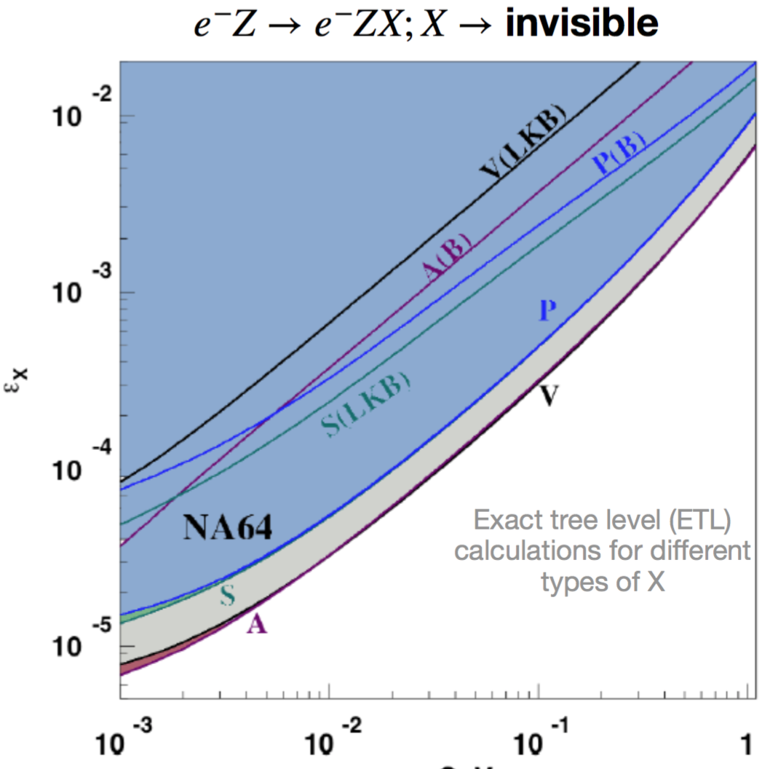
Limits on generic boson and (g-2)_{e}
Consider also Scalar,
Pseudoscalar, Axial vector
Andreev et al.
PRL 126, 211802 (2021)
Results (tension) on Δa_{e} :
LKB +1.6σ,
Berkley -2.4σ
m_{X} [GeV]
Notes:
-PF muon ID uses information from additional sub-detectors
to suppress further background.
-Isolated Muons are required to pass Loose selection
-Muons inside jets need higher identification criteria
to reject punch through and fakes so they are subject to
tighter selection
-Some muons that fail the tight selection can be later
recovered during the track-calorimeter cluster linking

Slide 21
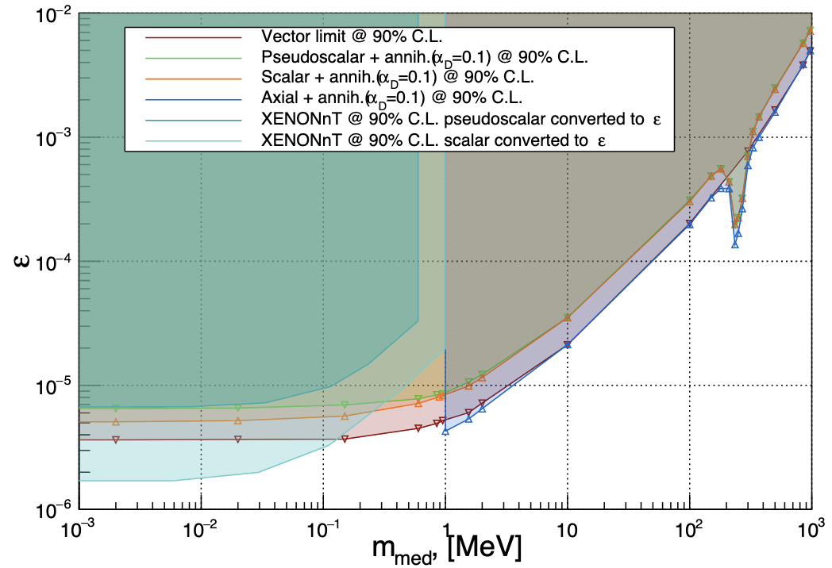
Limits on generic boson, new analysis
Preliminary, with 2022 data
Consider also Scalar,
Pseudoscalar, Axial vector
+Annihilation
Extend to 1 KeV
Plan is to publish together with 2023 - 2026
Notes:
-PF muon ID uses information from additional sub-detectors
to suppress further background.
-Isolated Muons are required to pass Loose selection
-Muons inside jets need higher identification criteria
to reject punch through and fakes so they are subject to
tighter selection
-Some muons that fail the tight selection can be later
recovered during the track-calorimeter cluster linking

Slide 22
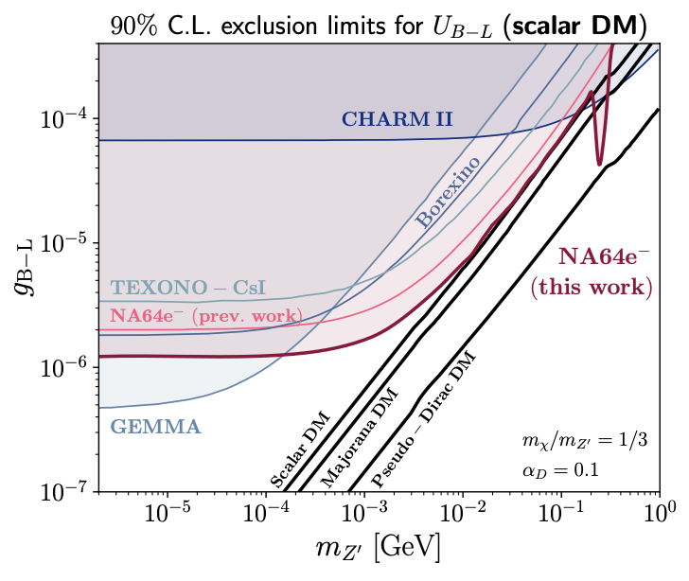
Constraints on B-L Z’ (decaying to SM particles)
Better sensitivity than
neutrino experiments!
Phys. Rev. Lett. (2022)
New result is being prepared
for publication (datasets up to
2022, 3 times more statistics)
Notes:
-PF muon ID uses information from additional sub-detectors
to suppress further background.
-Isolated Muons are required to pass Loose selection
-Muons inside jets need higher identification criteria
to reject punch through and fakes so they are subject to
tighter selection
-Some muons that fail the tight selection can be later
recovered during the track-calorimeter cluster linking

Slide 23
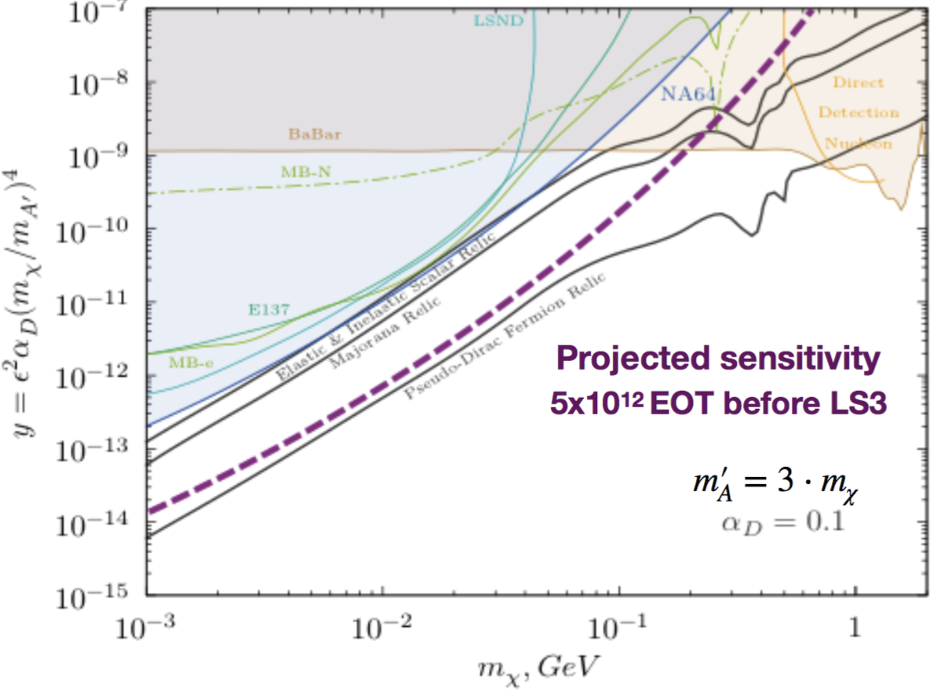
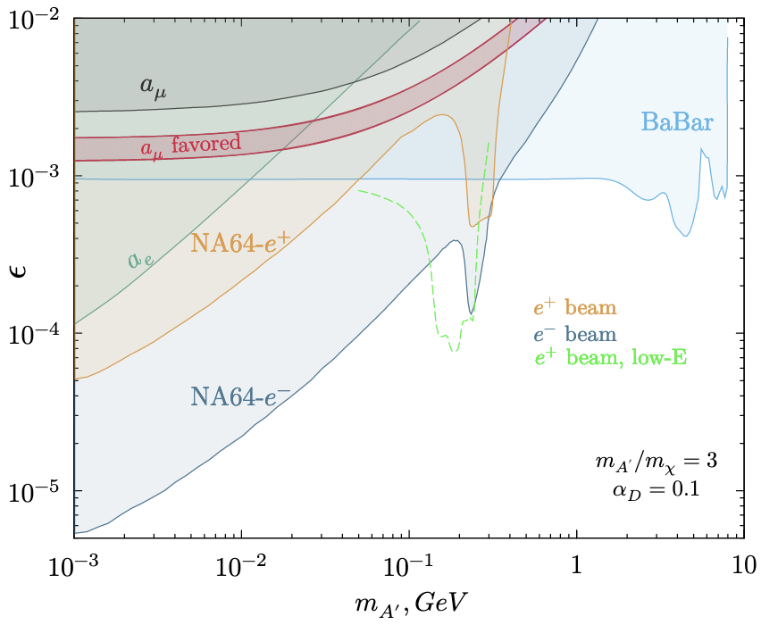
Sensitivity to y and some popular sub-GeV Thermal Dark Matter models
How to improve sensitivity above 100 MeV?
Annihilation. Additional positron run in 2022 (already analysed), positron run at 70 GeV in 2023, 60, 40 GeV planned
NA64μ at the muon beam M2, later in this talk.
Analysed positron data 2022,
green dashed – expected from
40 - 70 GeV positrons with ~10¹¹ POT
Additional region in positron beam is larger
Notes:
-PF muon ID uses information from additional sub-detectors
to suppress further background.
-Isolated Muons are required to pass Loose selection
-Muons inside jets need higher identification criteria
to reject punch through and fakes so they are subject to
tighter selection
-Some muons that fail the tight selection can be later
recovered during the track-calorimeter cluster linking

Slide 24
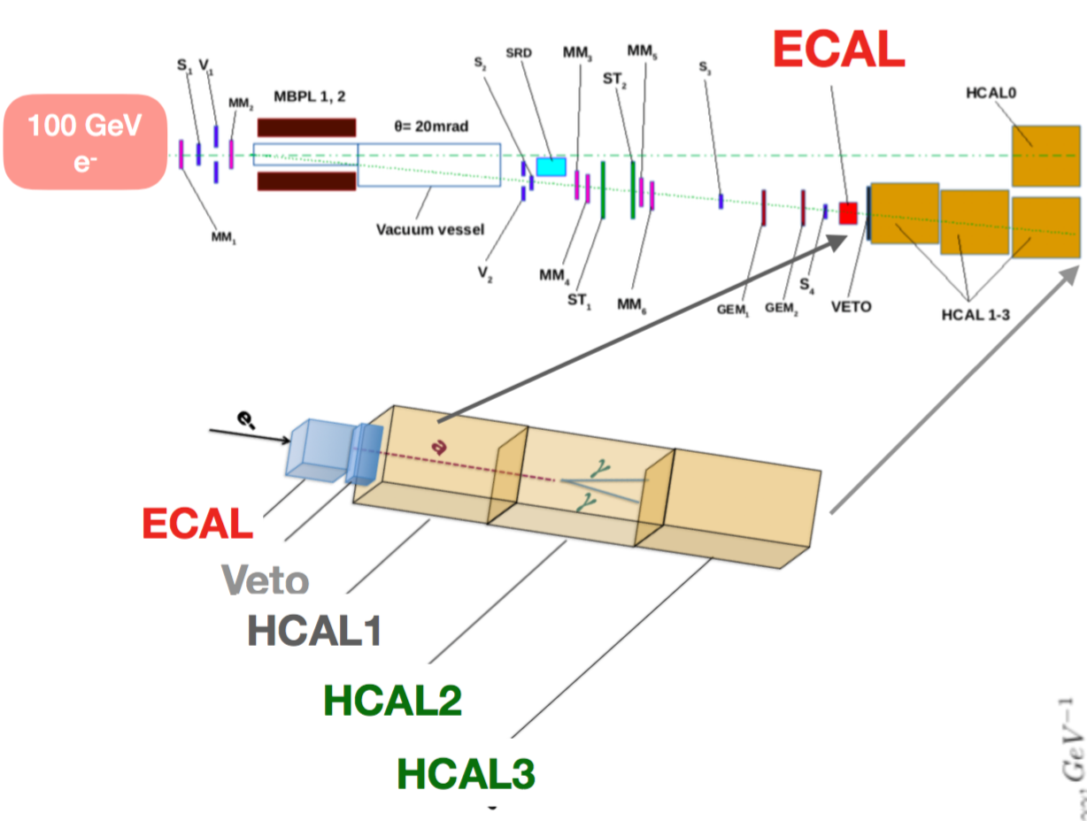
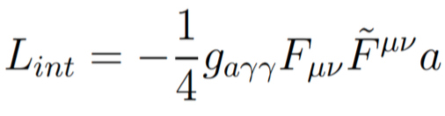
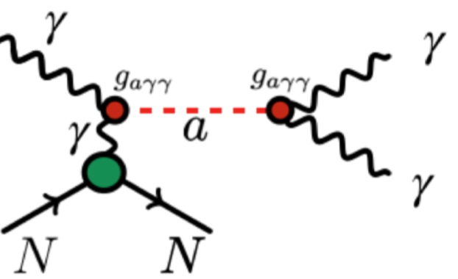
Axion-like particles (ALP) coupled to photons
New way of using the invisible mode geometry: visible decays!
Produced via Primakoff effect of gamma conversion on nuclei
Notes:
-PF muon ID uses information from additional sub-detectors
to suppress further background.
-Isolated Muons are required to pass Loose selection
-Muons inside jets need higher identification criteria
to reject punch through and fakes so they are subject to
tighter selection
-Some muons that fail the tight selection can be later
recovered during the track-calorimeter cluster linking

Slide 25
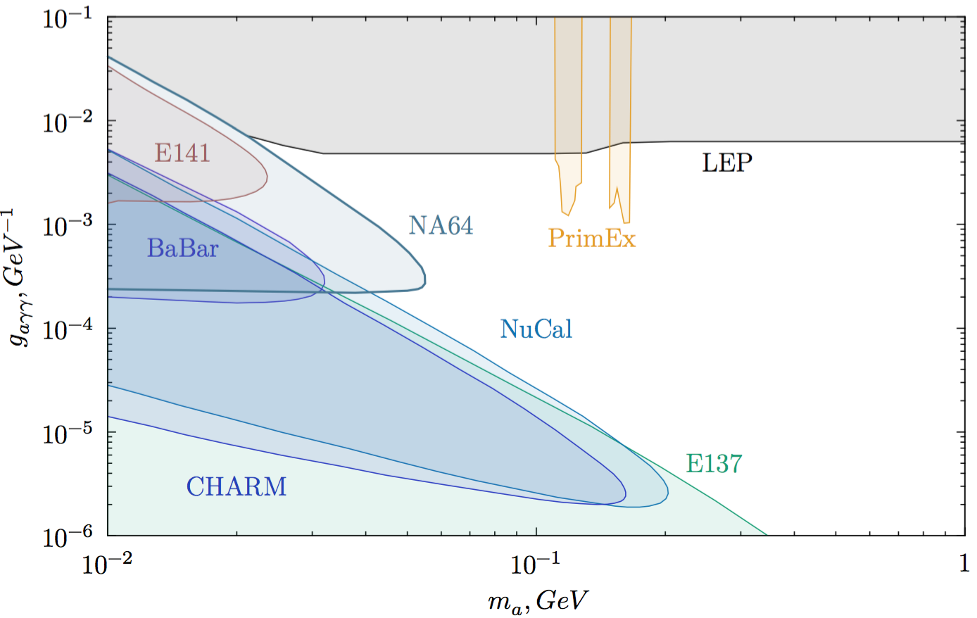
ALP search results (data 2016 – 2018)
Notes:
-PF muon ID uses information from additional sub-detectors
to suppress further background.
-Isolated Muons are required to pass Loose selection
-Muons inside jets need higher identification criteria
to reject punch through and fakes so they are subject to
tighter selection
-Some muons that fail the tight selection can be later
recovered during the track-calorimeter cluster linking

Slide 26
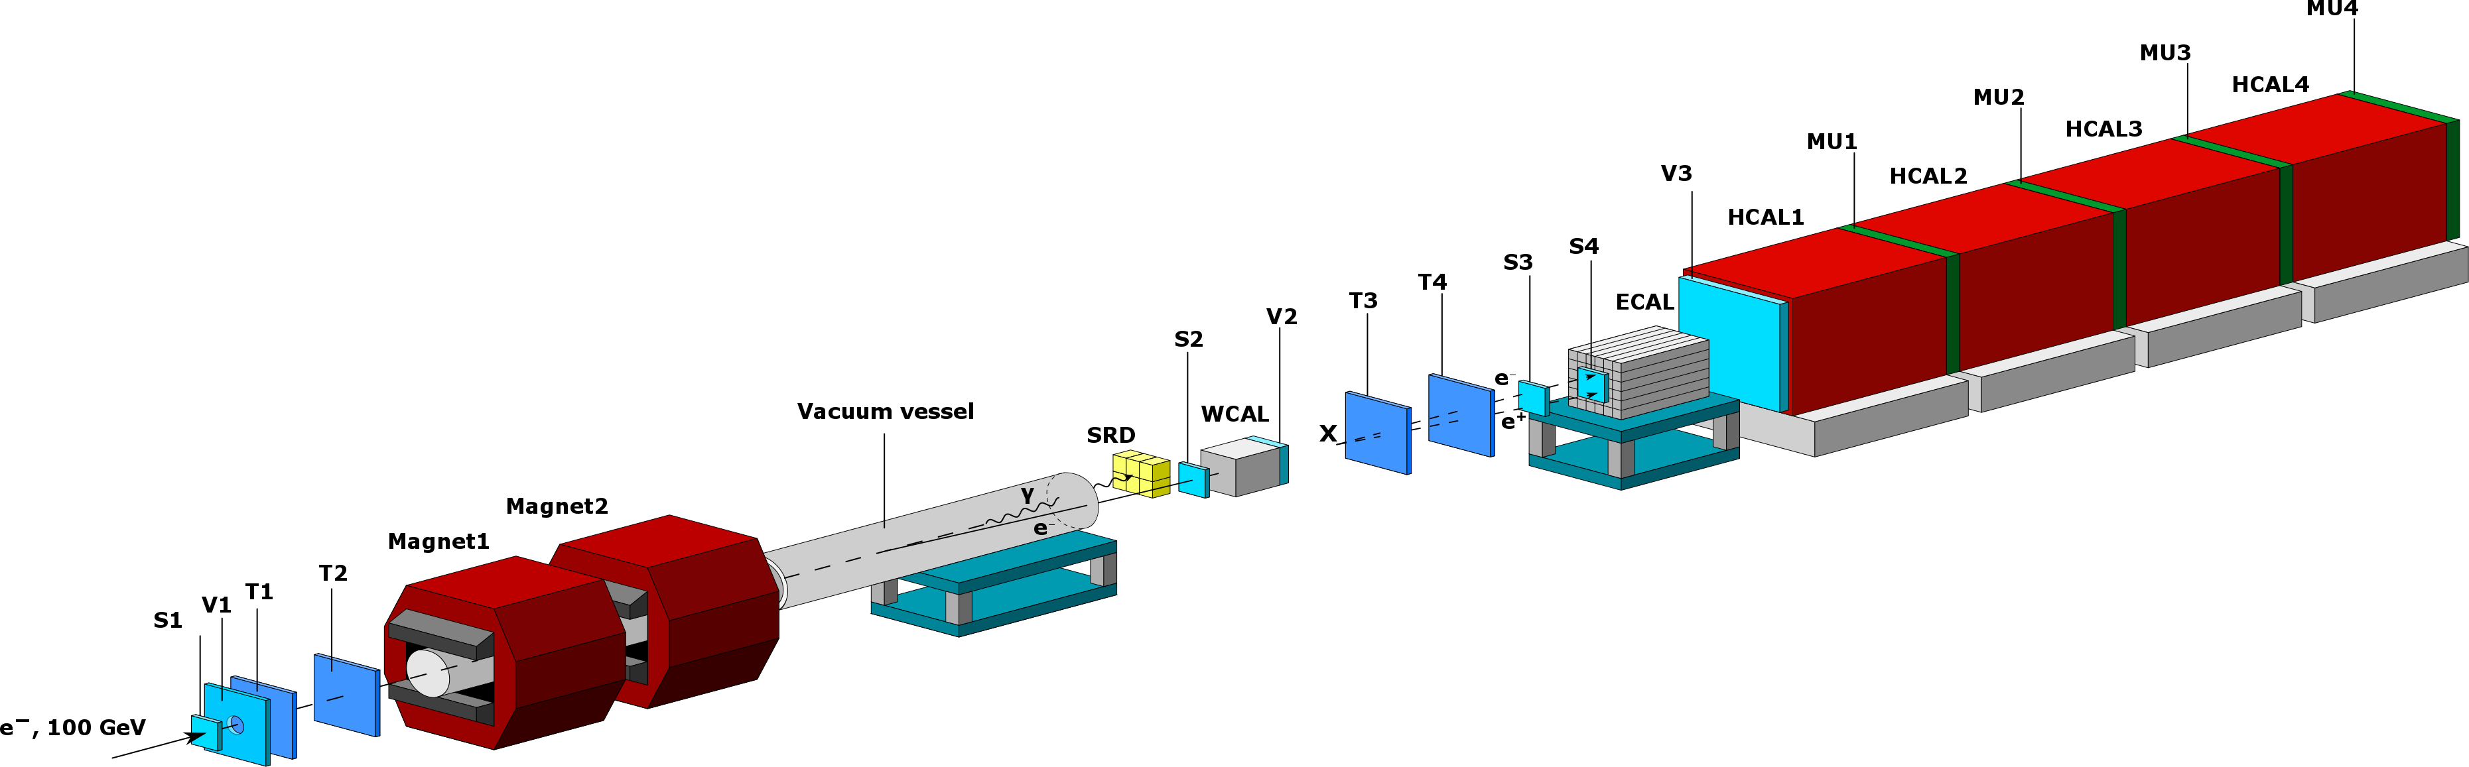
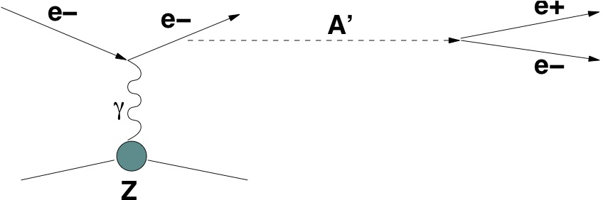
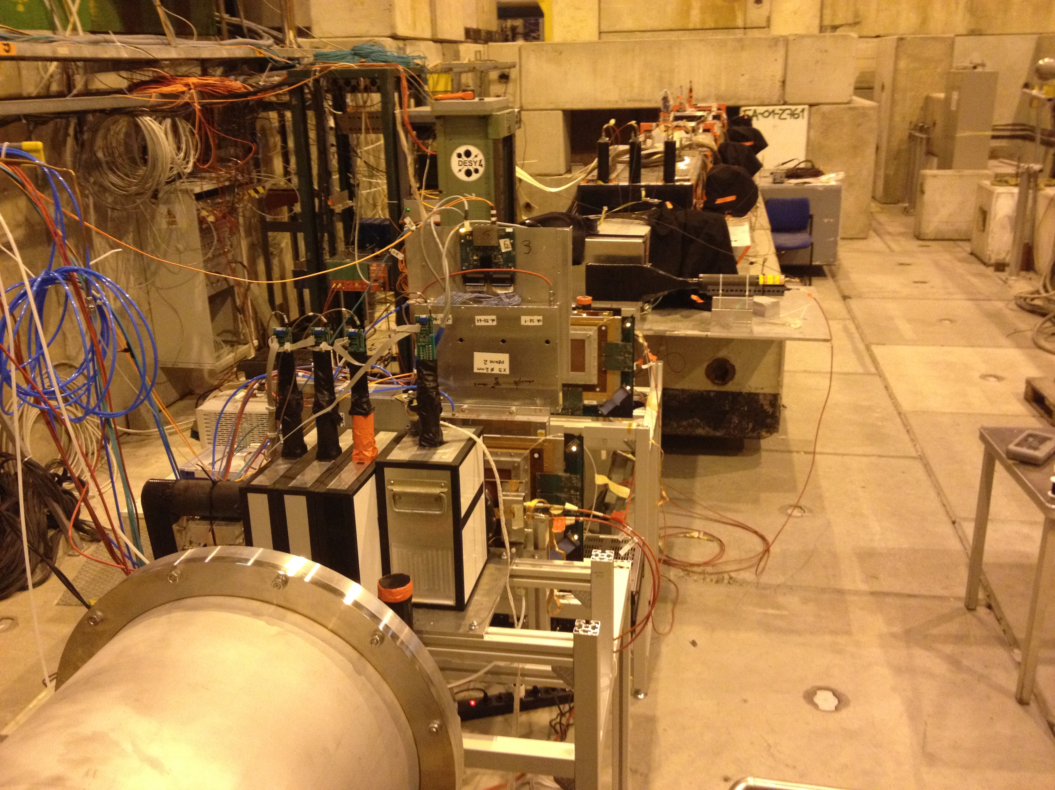
Search for X(A´)->e⁺e⁻ decays
X,
σ_{x}/σ_{γ}~10⁻¹⁰, τ_{x}~10⁻¹³ s
X,
Compact tungsten calorimeter WCAL
X decays outside WCAL dump
Signature: two separated showers from a single e-
E_{WC}< E₀, and E₀= E_{WC}+ E_{EC}
θ_{e+e-} too small to be resolved

Slide 27
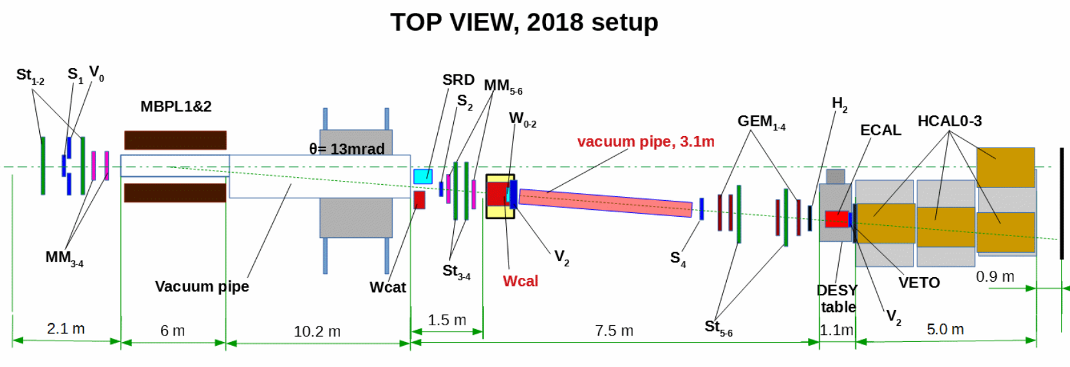
Setup optimization
Second run (2018), with 3x10¹⁰ EOT was performed with the visible mode configuration optimized for bigger ε (short-lived X) and better background suppression: 150 GeV beam, veto counter inside WCAL box, vacuum decay tube, larger distance WCAL - ECAL

Slide 28
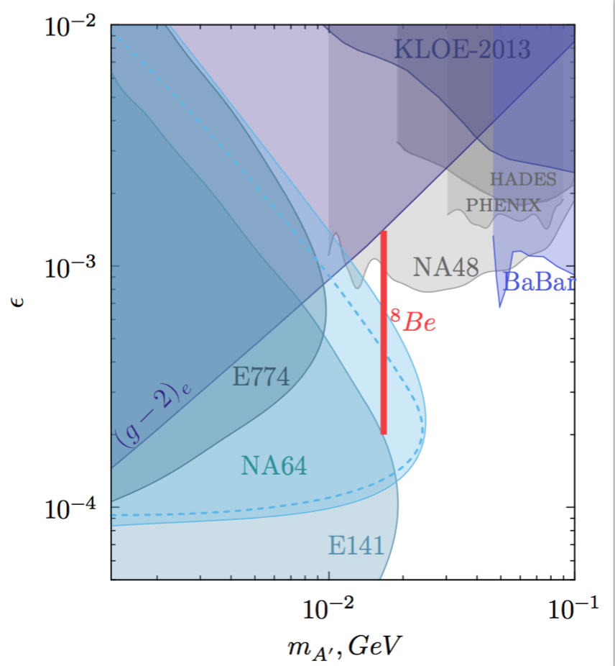
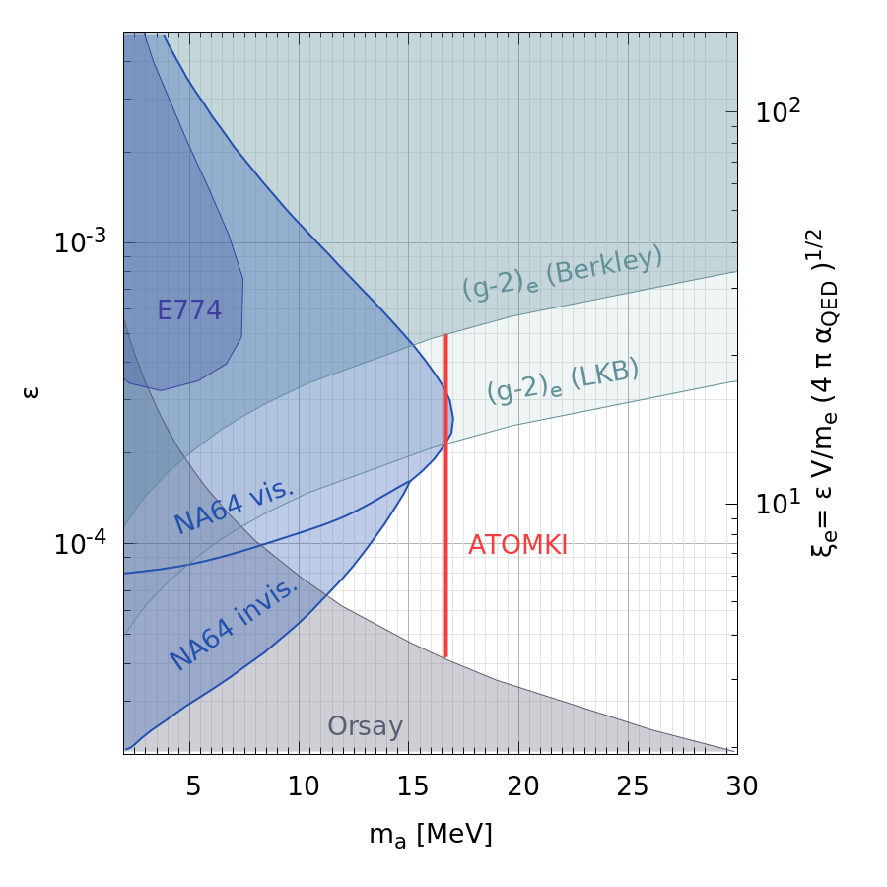
Results with 8.4 x 10¹⁰ EOT (+invis. mode data for pseudoscalar)
Later, NA62 excluded axion decaying to e⁺_{e}⁻: https://arxiv.org/pdf/2307.04579.pdf
Vector, PRD 107, 071101 (R) 2020
New: Pseudoscalar, arXiv: 2104.13342 [hep-ex]

Slide 29
New visible mode projects
Idea: the bremsstrahlung processes can be enhanced in crystals. Shorter shower, increased probability for X particle to exit from the target.
2026 – test at H4
Further improvement of the visible mode setup: spectrometer, invariant mass reconstruction. Description of this project is published.
Notes:
-PF muon ID uses information from additional sub-detectors
to suppress further background.
-Isolated Muons are required to pass Loose selection
-Muons inside jets need higher identification criteria
to reject punch through and fakes so they are subject to
tighter selection
-Some muons that fail the tight selection can be later
recovered during the track-calorimeter cluster linking

Slide 30
NA64μ
Two stages:
Study the possibility to explain the (g-2) anomaly by the new muonphilic WIP
Complement the NA64e
Notes:
-PF muon ID uses information from additional sub-detectors
to suppress further background.
-Isolated Muons are required to pass Loose selection
-Muons inside jets need higher identification criteria
to reject punch through and fakes so they are subject to
tighter selection
-Some muons that fail the tight selection can be later
recovered during the track-calorimeter cluster linking

Slide 31
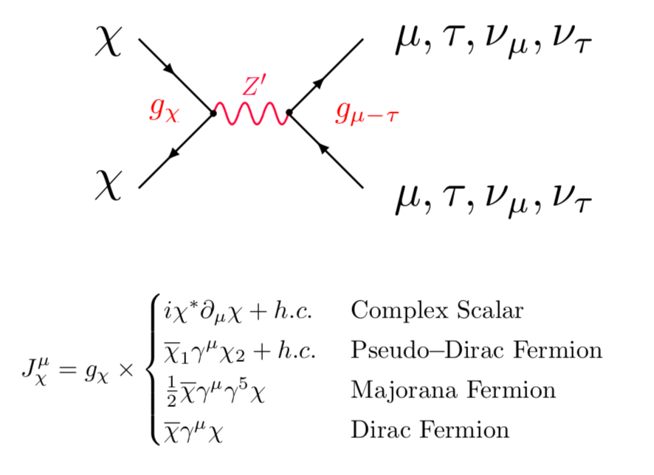
L_{μ}-L_{τ} Charged Dark Matter and Z_{μ} mediator
Z_{μ} mediator
Dark Sector
SM
LDM coupled predomimantly to generations 2,3
free parameters m_{χ}, m_{Zμ} , g_{χ}, g_{μ}
Z_{μ} decays:
m_{Zμ}<2m_{χ}-decays into SM, Z_{μ} → νν, μ⁺μ⁻, τ⁺τ⁻
m_{Zμ}>2m_{χ}- invisible decays into DM: Z_{μ} →χχ, νν, α_{D} >> α_{SM}, α_{D}=g_{χ}²/4π, α_{SM}=g_{μ}²/4π
Cross section for χ−DM annihilation:
Γ_{inel} = n_{χ}< σv >
σν ≈ [(g_{χ}g_{μ} )²(m_{χ}/m_{A´})⁴]/m_{χ}² = y/m_{χ}² ;
y=[(g_{χ}g_{μ} )²(m_{χ}/m_{A´})⁴] -
useful variable to compare FTE
sensitivities
^{Gninenko, Krasnikov 1801.10448}
Kahn, Krnjaic, Tran, Whitbeck 1804.03144

Slide 32
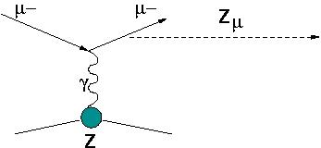
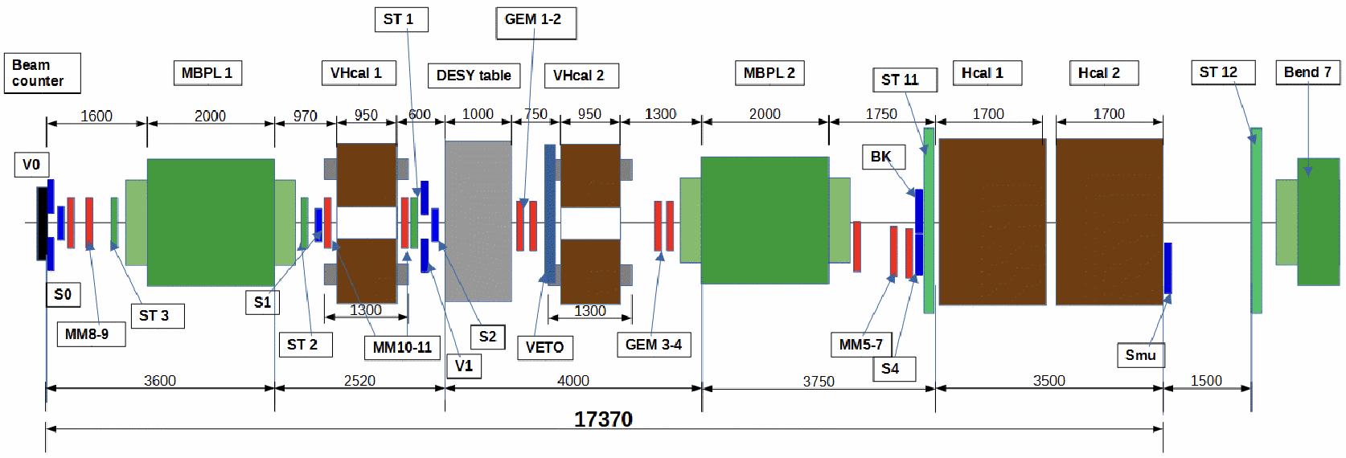
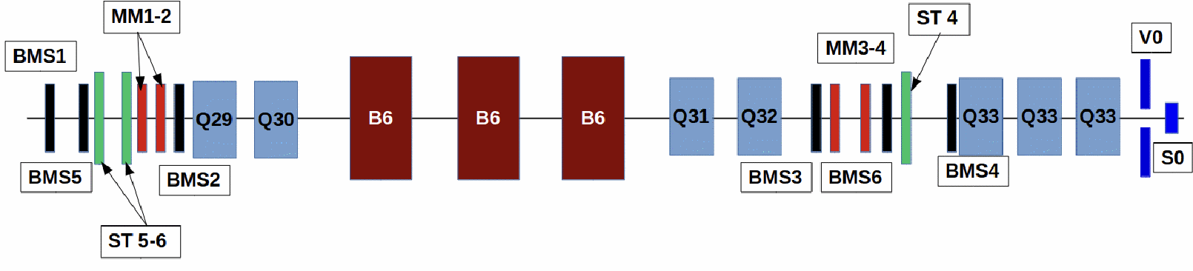
Search for Z_{μ} in missing energy events on M2 beam
Motivated by (g-2)_{μ} measurements
Proposal NA64μ (2019)
Main components :
100-160 GeV μ- beam, I_{μ}~10⁷μ/spill.
in μ tagging: BMS+MS1(MBPL+tracker)
out μ tagging: MS2 (2MBPL+tracker)
4π fully hermetic ECAL+Veto+ HCAL
Signature:
in: 160 GeV μ- track
out: < 80 GeV μ- track (recoil)
small energy in the ECAL, Veto, HCAL
Sensitivity ~ g_{μ}²

Slide 33
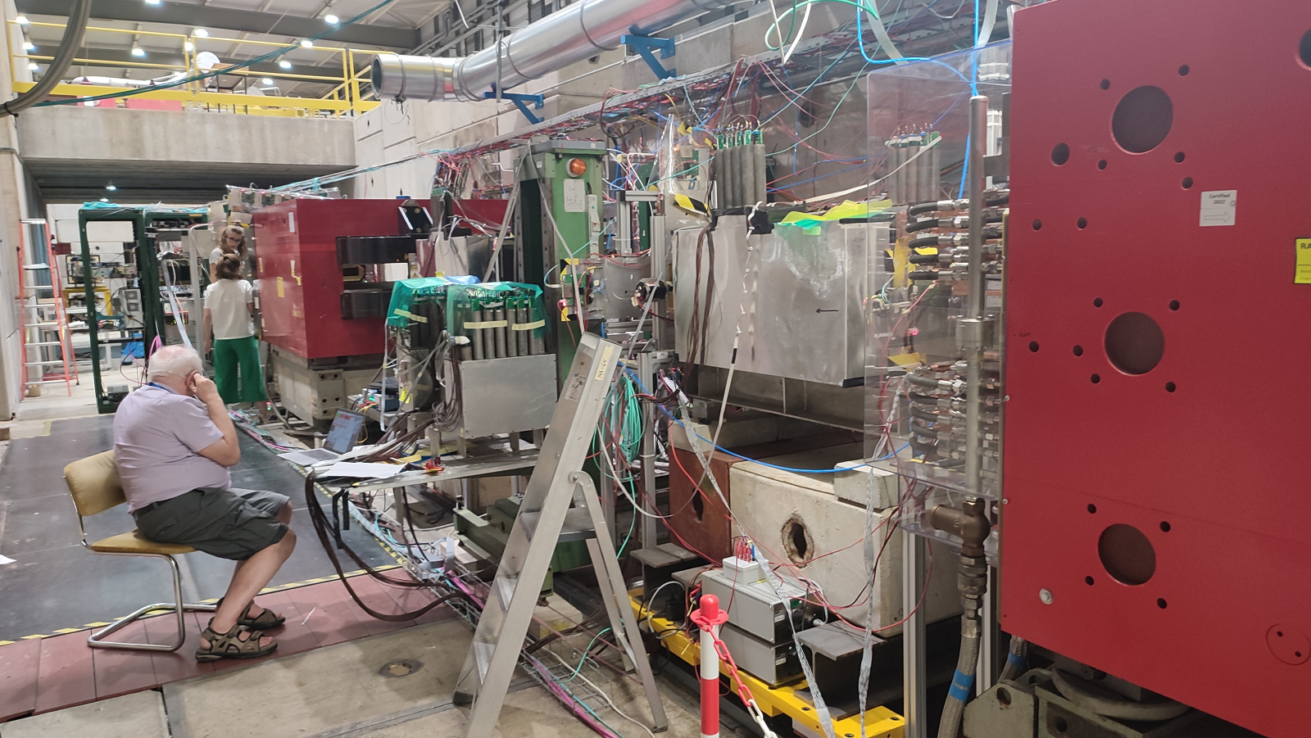
NA64μ experiment setup, physics run 2023
Notes:
-PF muon ID uses information from additional sub-detectors
to suppress further background.
-Isolated Muons are required to pass Loose selection
-Muons inside jets need higher identification criteria
to reject punch through and fakes so they are subject to
tighter selection
-Some muons that fail the tight selection can be later
recovered during the track-calorimeter cluster linking

Slide 34
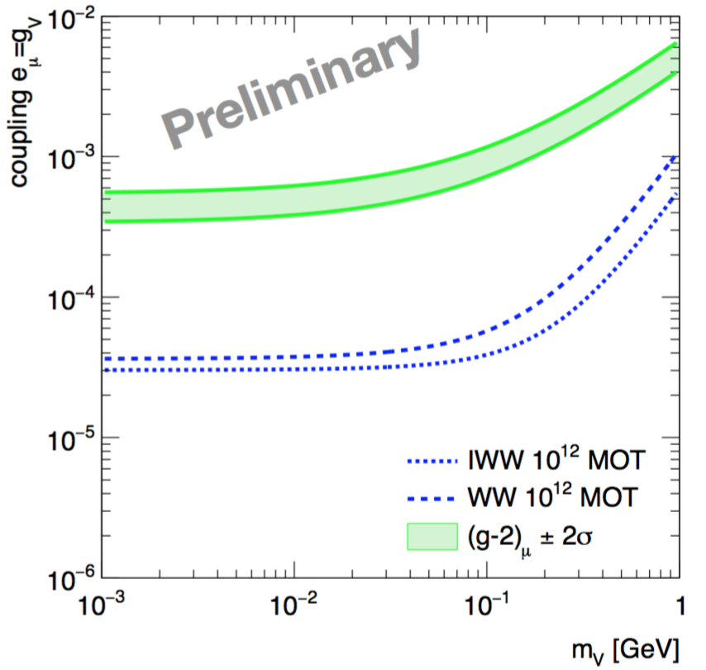
Pilot runs on M2 in 2021 and 2022 are followed by the physics runs
Pilot runs to check
trigger rate and
noise conditions
~4x10¹⁰ MOT
Using the experience from pilot
runs we upgraded tracker and
performed physics runs in 2023
and 2024: 3.5x10¹¹ MOT.
Analysis is ongoing
New wide HCAL
New special ECAL

Slide 35
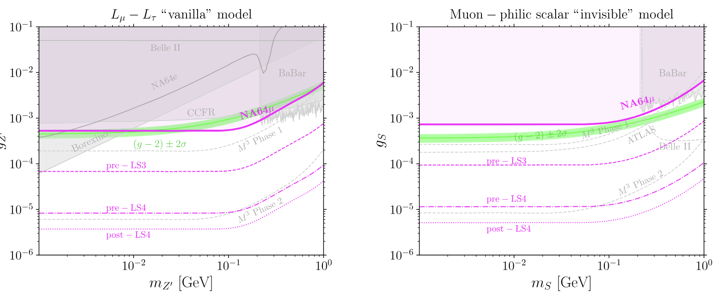
Physical analysis of the 2022 NA64mu data
Phys. Rev. D 110, 112015 (2024)
~2x10¹⁰ MOT

Slide 36
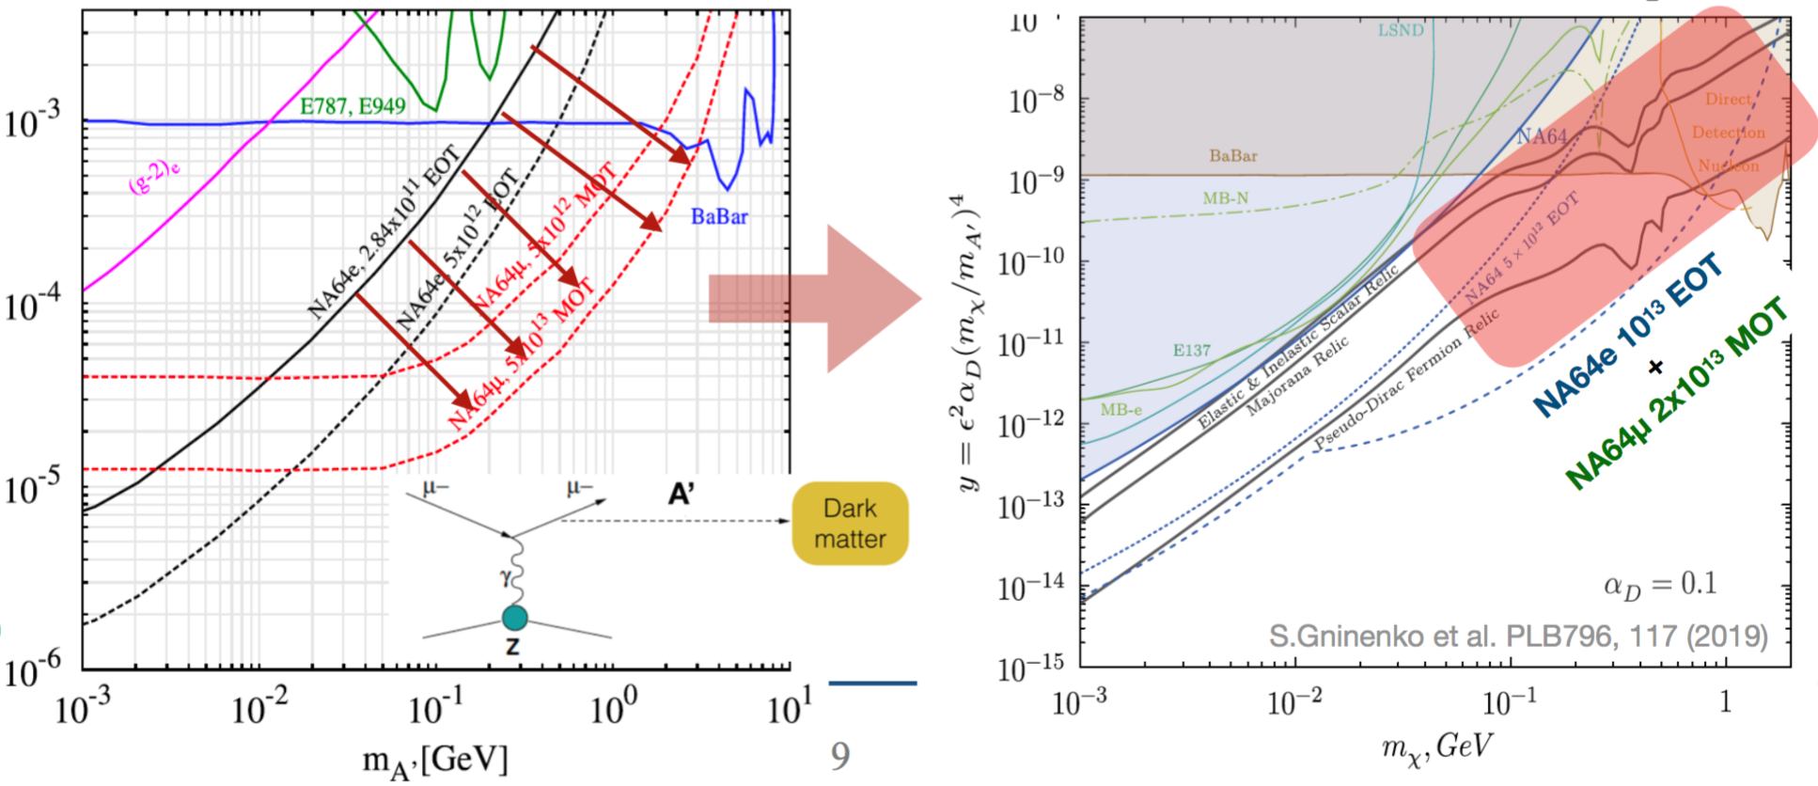
Searches for A’ with NA64μ
Better sensitivity to heavy A’ (>100 MeV)

Slide 37
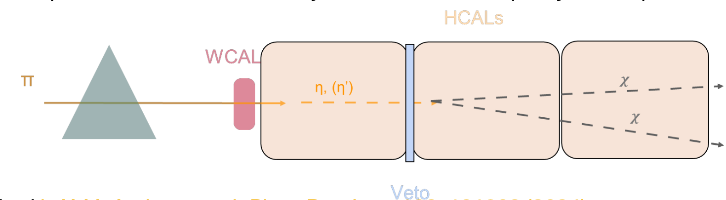
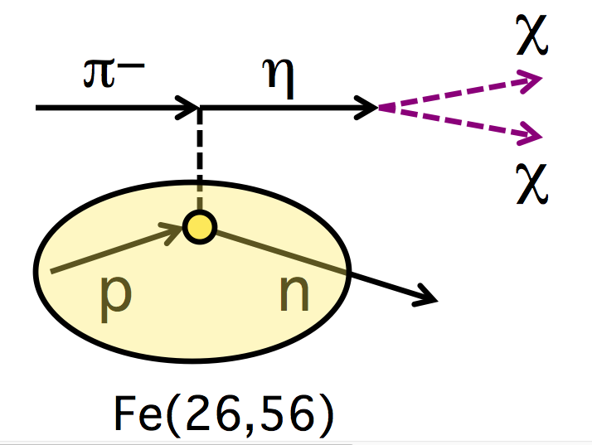
NA64h: Search for dark sector coupled mainly to quarks
(e.g.: π⁰, η, η’, K⁰_{S,L},..→ inv decays)
Run at H4 in 2022 at 50 GeV,
Single track from 50 GeV p-
Events with E_{HC} ≈ E₀ - test NA64mu
MIP in WCAL and S
Almost no energy in HCAL: E_{miss} ~ E₀
BG: π, μ decays ~ 10⁻¹¹/pot
Br(η -> inv) < ~ 10⁻⁵-10⁻⁴ (BaBar/BESIII)
η, η’, K0 – production:
π(K) Z->η(K⁰) (Z-1)

Slide 38
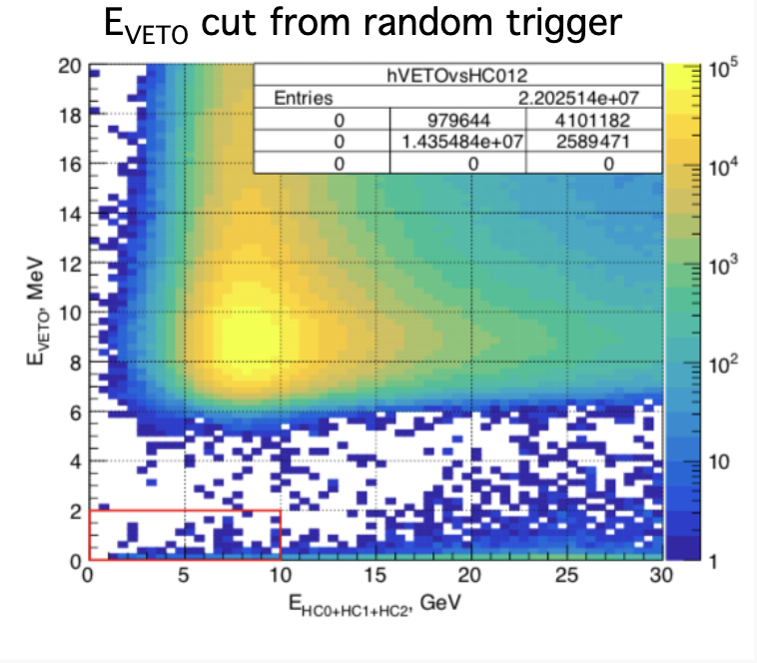
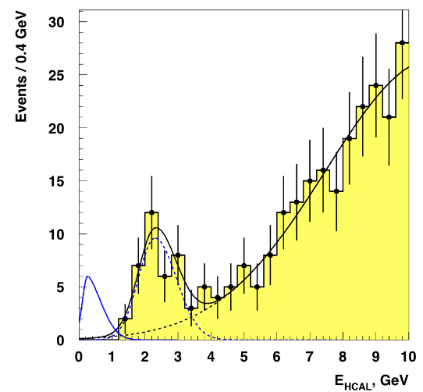
NA64h: Search for dark sector coupled mainly to quarks
Preliminary
Preliminary
Yellow – BG. Peak at ~2.5 GeV is from K⁻ decays
Blue curve – signal + noise (from random trigger)

Slide 39
NA64h: Search for dark sector coupled mainly to quarks
Results in Phys. Rev. Lett. 133, 121803 (2024)
Preliminary results on Г/Гtot: η : < 1.1 ∗ 10⁻⁴ existing: 1 x 10⁻⁴ (BESIII)
Preliminary results on Г/Гtot: η’ : < 2.3 ∗ 10⁻⁴ existing: 6 x 10⁻⁴ (BESIII)
The results are dominated by the uncertainty on the production reaction
cross section (charge exchange process).
The measurement in the closest region, on Al, Cu at 20 – 48 GeV,
is performed in IHEP Protvino

Slide 40
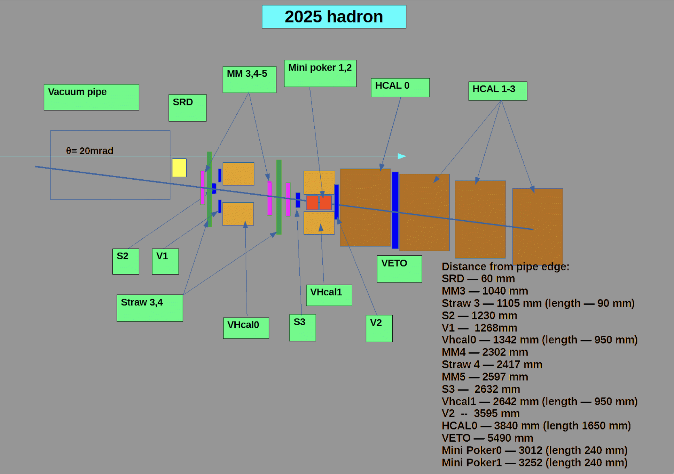
NA64h: New setup in 2025
(e.g.: π⁰, η, η’, K⁰_{S,L},..→ inv decays)
Run at H4 at 50 GeV
η, η’, K0 – production:
π(K) Z->η(K⁰) (Z-1)
Cerencov counters ID
Preliminary:
First result on K⁰?

Slide 41
Summary
The NA64 experiment produced several important results in the search for light Dark Matter (LDM, sub-GeV mass range) coupled universally to leptons and quarks. With the milestone statistics of ~10¹² EOT it provides the world-leading constraints on the benchmark LDM models
The plan is to significantly increase the sensitivity and maximally cover the regions of predictive thermal Dark Matter models
One of the possibilities to improve sensitivity is to use positron beam (POKER project)
The NA64μ experiment started in 2021. The purpose is to obtain more direct answer to the question about the (g-2)_{μ} explanation by Dark Matter and to improve sensitivity to A’ for the masses > 100 MeV (complementarity)
The searches for X(17) particle that could explain ATOMKI anomaly : work on new projects
NA64h: the proof-of-concept in 2022, continued in 2025.
Two test runs at the PS beam are performed: possibility to work during LS3
Other planned searches are μ - τ conversion, LFV DM production, K0 oscillations to DM etc.
Notes:
-PF muon ID uses information from additional sub-detectors
to suppress further background.
-Isolated Muons are required to pass Loose selection
-Muons inside jets need higher identification criteria
to reject punch through and fakes so they are subject to
tighter selection
-Some muons that fail the tight selection can be later
recovered during the track-calorimeter cluster linking

Slide 42
Backup slides
Backup

Slide 43
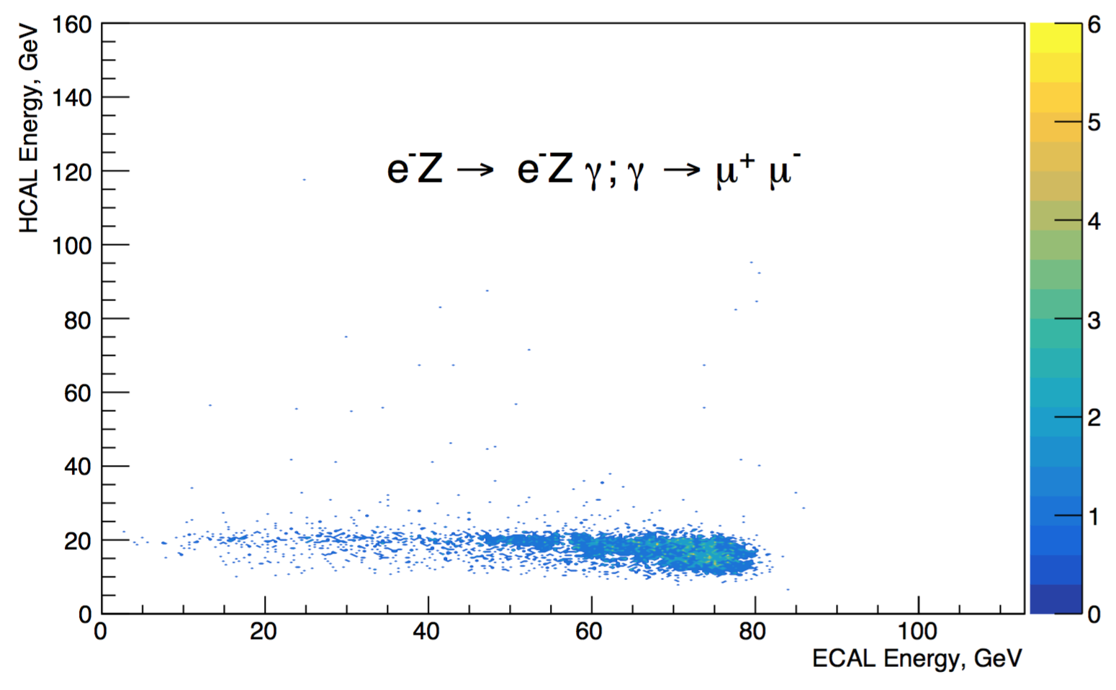
Dimuon production as a reference process
There is an excellent reference process: gamma to muons conversion. It is rather
rare and has many similarities with our
signal
Millions of dimuon pairs with both muons reaching all HCAL modules are registered in NA64
The process is available in GEANT4, off by default
We bias the cross section in GEANT4 by a factor of 200 in order to have good statistics with reasonable CPU time.
Reasonable agreement DATA - MC
Notes:
-PF muon ID uses information from additional sub-detectors
to suppress further background.
-Isolated Muons are required to pass Loose selection
-Muons inside jets need higher identification criteria
to reject punch through and fakes so they are subject to
tighter selection
-Some muons that fail the tight selection can be later
recovered during the track-calorimeter cluster linking

Slide 44
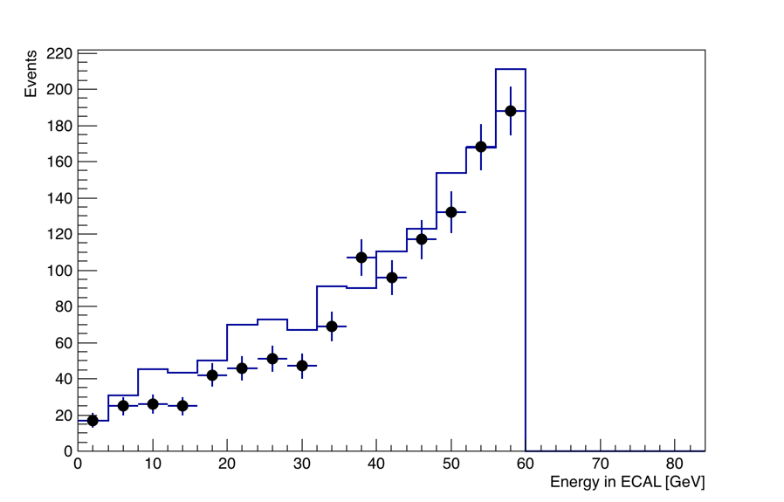
Dimuon reconstruction
Dimuons selection: E_{ECAL} < 60 GeV
3 < E_{HCAL1} < 7
3 < E_{HCAL2} < 7
Notes:
-PF muon ID uses information from additional sub-detectors
to suppress further background.
-Isolated Muons are required to pass Loose selection
-Muons inside jets need higher identification criteria
to reject punch through and fakes so they are subject to
tighter selection
-Some muons that fail the tight selection can be later
recovered during the track-calorimeter cluster linking

Slide 45
ALP search strategy
In addition to invisible decays beyond the detector (missing energy signature) look for decays in HCAL2, HCAL3 with HCAL1 as a veto
Allows softer cuts on energy deposition in ECAL
Background: punch-through neutrons and K⁰
Final cut on R = (periphery cells)/(central cell), strong suppression of hadrons
A
Results
Future plans
Conclusion

Slide 46
Search for new X-bosons and Dark Photons decaying to e⁺e⁻
Notes:
-PF muon ID uses information from additional sub-detectors
to suppress further background.
-Isolated Muons are required to pass Loose selection
-Muons inside jets need higher identification criteria
to reject punch through and fakes so they are subject to
tighter selection
-Some muons that fail the tight selection can be later
recovered during the track-calorimeter cluster linking

Slide 47
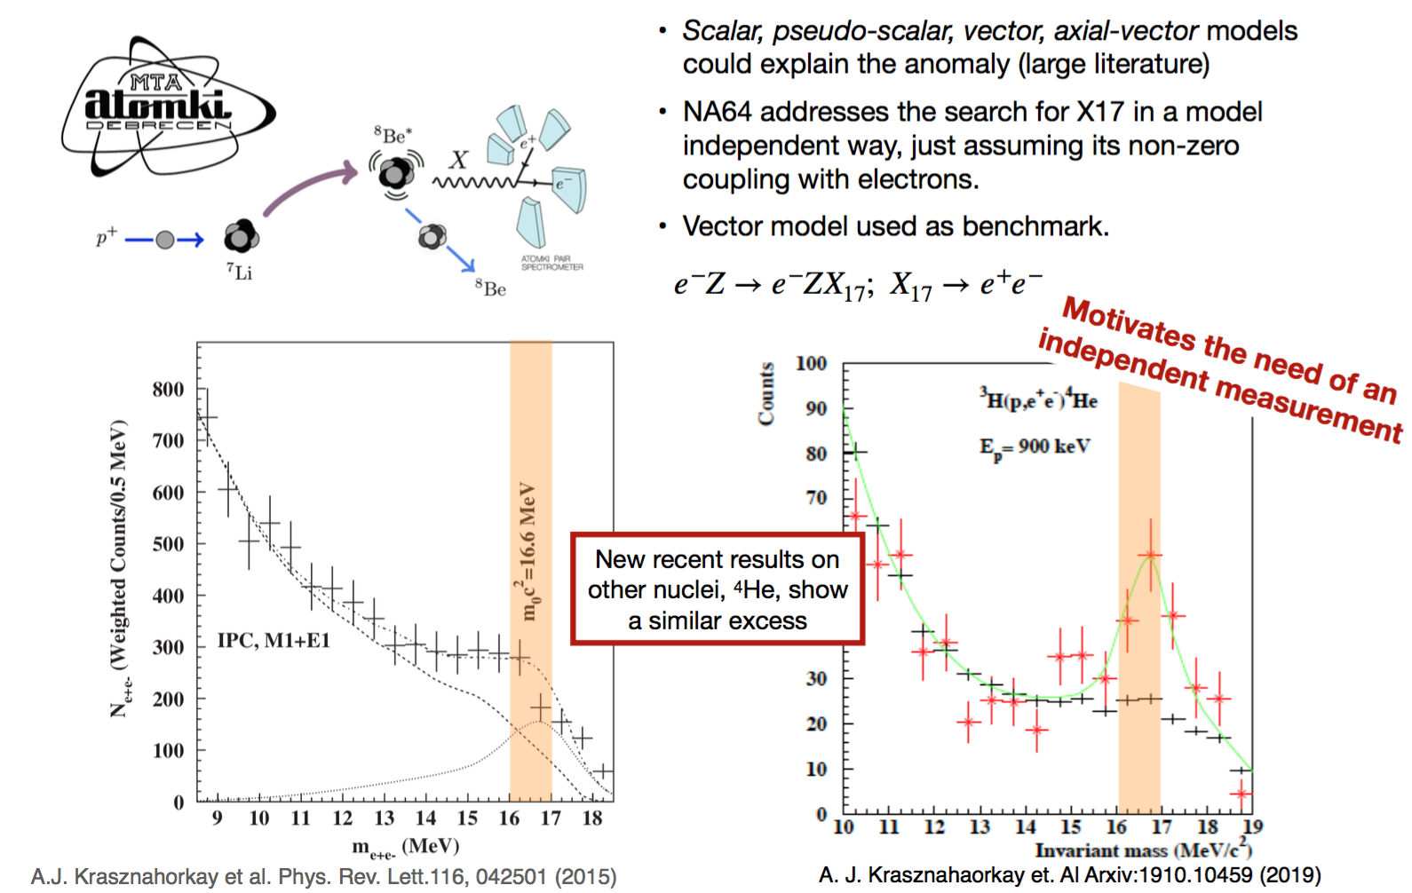
ATOMKI anomaly
Notes:
-PF muon ID uses information from additional sub-detectors
to suppress further background.
-Isolated Muons are required to pass Loose selection
-Muons inside jets need higher identification criteria
to reject punch through and fakes so they are subject to
tighter selection
-Some muons that fail the tight selection can be later
recovered during the track-calorimeter cluster linking

Slide 48
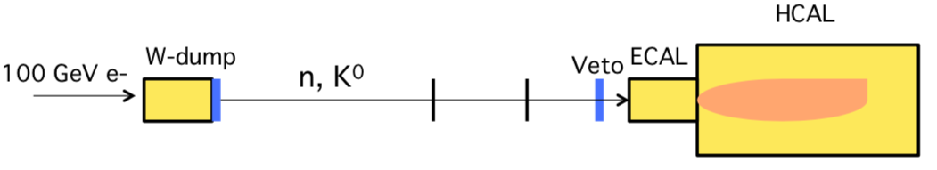
Main background from K⁰_{S} ->π⁰ π⁰ -> γ’s -> e⁺e⁻ decay chain
HCAL
n, K⁰
Veto
ECAL
We used control sample to estimate this BG: fully neutral events
We performed also a search for pseudoscalar bosons.
Here, we used also data collected in the invisible mode
configuration, similarly to the ALP search

Slide 49
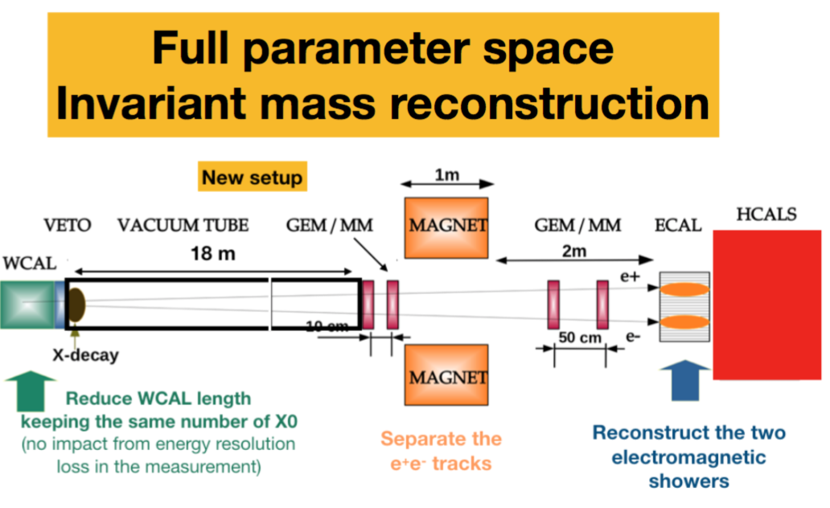
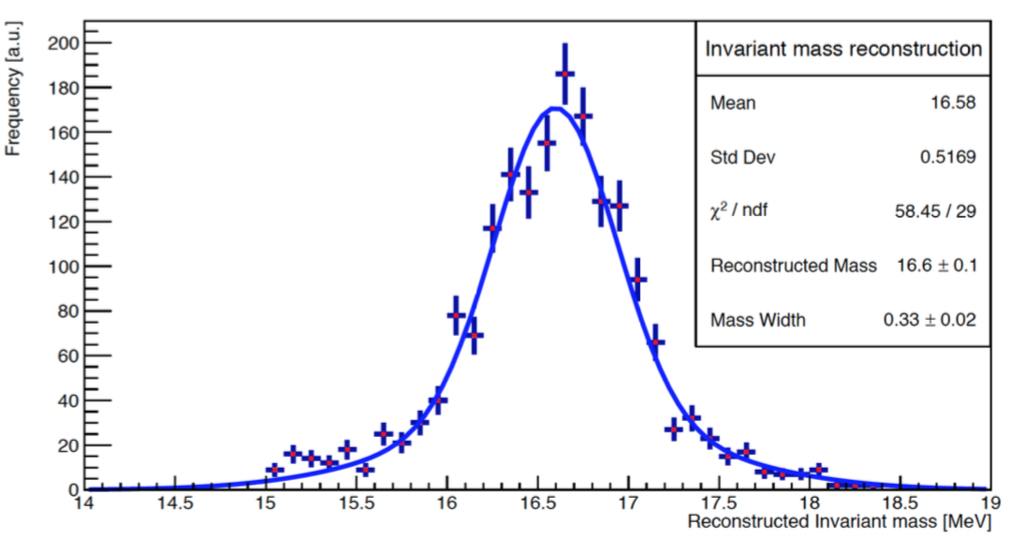
Plans for the visible mode (2024?)
For vector:
cover ε up to
1.3 x 10⁻³
with 10¹² EOT
New further optimized tungsten calorimeter WCAL
Long decay tube
Large area M
Wide ECAL
Project described in
EPJ C 80 12 1159 (2020)

